Slide 1
Asialoglycoprotein receptor targeted optical and magnetic resonance imaging and therapy of liver fibrosis using pullulan stabilized multi‑functional iron oxide Nano probe
IF: 4.379
Presented by:
Sahba Mofazal

Slide 2
1. Abstract
Early diagnosis and therapy of liver fibrosis is of utmost importance.
A polysaccharide polymer, pullulan stabilized iron oxide nanoparticle (P-SPIONs) enabled high liver specificity via asialoglycoprotein receptor mediation.
Longitudinal and transverse magnetic relaxation rates of 2.15 and 146.91 ­mM−1 ­s−1 respectively and a size of 12 nm, confirmed the T2 weighted magnetic resonance imaging (MRI) efficacy of P-SPIONs.
A current of 400A on 5 mg/ml of P-SPIONs raised the temperature above 50 °C, to facilitate effective hyperthermia.
a NIR dye conjugation facilitated targeted dual imaging in liver fibrosis models.

Slide 4
1 . فیبروز کبدی زمانی اتفاق می‌افتد که بافت سالم کبد (زخم) آسیب ببیند، بنابراین نمی‌تواند عملکرد سابق را داشته باشد.
2. فراوان شدن این زخم‌ها در کبد باعث سیروز کبدی می‌شود.
3. پزشکان اغلب فیبروز کبد را در مراحل خفیف تا متوسط ​​تشخیص نمی‌دهند. زیرا فیبروز کبد معمولاً علائمی ندارد، تا زمانی که قسمت زیادی از کبد آسیب ببیند. وقتی که آسیب کبدی به مرحله پیشرفته می‌رسد فرد علائم زیر را دارد؛
کاهش اشتها
بروز مشکلات شناختی مانند مشکل حافظه
تجمع مایعات در پا‌ها یا شکم
زردی یا یرقان (زرد شدن پوست و چشم)
حالت تهوع
کاهش وزن بدون دلیل
ضعف
4. فیبروز کبدی در اثر آسیب ‌دیدن یا التهاب کبد رخ می‌دهد. سلول‌های کبد باعث ترمیم زخم می‌شوند. در طی این ترمیم، پروتئین‌های اضافی مانند کلاژن و گلیکوپروتئین‌ها در کبد جمع می‌شوند. سرانجام، پس از ترمیم‌های بسیار، سلول‌های کبدی (معروف به هپاتوسیت‌ها) دیگر نمی‌توانند خود را ترمیم کنند.
در نتیجه پروتئین‌های اضافی باعث زخم یا فیبروز کبدی می‌شود.
5. انواع مختلفی از بیماری‌های کبدی وجود دارد که می‌تواند منجر به فیبروز شود، شامل:
هپاتیت خودایمنی
انسداد صفراوی
زیادی آهن در خون وبیماری کبد چرب غیرالکلی که شامل کبد چرب غیرالکلی و استئو هپاتیت غیرالکلی است.

Slide 5
این مواد از واحد های مالتوتریوز تشکیل شده و اساسا یک پلیمر پلی ساکارید است.
منبع اصلی و طبیعی این مواد از قارچی به نام Aureobasidium pullulans هست .

Slide 6
مواد کنتراست در MRI
مواد کنتراست مثبت مانند گادولینیوم چیلیت ها
اثر بر روی زمان آسایش T1
باعث افزایش سیگنال تصویر روشن تر
مواد کنتراست منفی مانند نانوذرات اکسید آهن
اثر بر روی زمان آسایش T2
باعث کاهش سیگنال
تصویر تیره تر

Slide 7
2. Introduction
Liver cancer is the third most leading cause of cancer death worldwide ,Hepatitis virus infection and alcohol abuse are the major cause behind the high incidence of this disease.
Hepatic architectural damage is the prime feature of most of the chronic liver diseases.
Fatty liver is the earliest stage of liver damage which develops through fibrosis to cirrhosis with a high chance of transforming it to hepatocellular cancer (HCC) .
An efficient management of the disease is possible if diagnosed at the curable stage of liver fibrosis whereas the management becomes difficult or rather not possible on advancement of the condition to cirrhosis and HCC .

Slide 8
2.Introduction
Various in vivo imaging modalities like Computed Tomography, MRI, Ultrasound and Positron Emission Tomography have been used for cancer diagnosis.
Among them MRI provides better sensitivity and specificity with high spatial and temporal resolution.
Even though MRI provides images with intrinsic contrast, authentic diagnosis of diseases like liver associated malignancies often requires the use of external agents to enhance the image contrast for better visualization.
For the diagnosis of early fatty changes within the liver, signal from the transverse relaxation of protons (T2) is preferred over longitudinal relaxation (T1).
contrast agents with enhanced transverse relaxivity such as surface modified super paramagnetic iron oxide nanoparticles (SPIONs) are preferred for liver imaging over conventional gadolinium-based contrast agents with longitudinal relaxation properties.

Slide 9
2. Introduction
Non-specificity is one of the major drawbacks of these blood pool contrast agents.
It is reported that low molecular weight polymer coatings have a tendency to cause osmotic nephropathy that leads to chronic renal failure.
Surface modification of iron oxide nanoparticles with biocompatible, water soluble polymers of high molecular weight is an efficient way to overcome the safety concerns of currently available iron oxide based MRI contrast agents.
a polysaccharide, pullulan, the malto-triose units of which has high specificity towards ASGPR over expressed on sinusoidal membranes of hepatocytes is used as the coating agent, in this study.

Slide 10
2. Introduction
In this study, hepatocyte-specific pullulan modified SPIONs with hydrodynamic size of 80 nm were synthesized for theranostic application of liver disease.
The synthesized P-SPIONs showed excellent magnetic relaxivity enabling high contrast for MRI.
The heat generation capacity of P-SPIONs under the influence of alternating current favoured magnetic hyperthermia based therapeutic intervention.
Moreover, P-SPIONs were further conjugated with an NIR emitting dye Atto-700 (PSPION-AT) to impart dual imaging capability for the material.

Slide 11
3.Materials and methods Synthesis of P‑SPIONs
a solution consisting of FeCl3 and FeCl2 with a molar ratio of 2:1 was mixed under N2 protection, followed by gradual addition of 1 M NaOH under vigorous stirring to obtain black Fe3O4 precipitate (SPIONs).
The above prepared SPIONs were re-dispersed in 1.2% pullulan to make the nanoparticles more stable, biocompatible and hepatocyte specific.
For the preparation of PSPION-AT, 20 μL of 1.3 μg/μL concentrated Atto dye was added to 10 ml of 1.2 mg/ mL P-SPIONs and ultra-sonicated for 6 h.

Slide 12
3.Materials and methods Physio‑chemical characterization
The core size of P-SPIONs was determined using transmission electron microscopy at 100 kV (TEM, JEM-2010, Hitachi-JEOL, Tokyo, Japan).
Using X’Pert PRO X-ray diffraction (XRD), phase and crystalline properties were investigated. Crystal structure was determined from the position and intensities of diffraction peaks observed in the diffraction angle range 2θ=10–80°.
The conjugation of SPIONs to pullulan was confirmed via Fourier transform infrared spectroscopy (FTIR) on a Thermo Nicolet 5700 FTIR spectrometer (USA).
Term gravimetric analysis (TGA) was used to evaluate the thermal decomposition properties of the prepared materials.

Slide 13
3.Materials and methods Magnetic property of P‑SPIONs
Magnetic properties of solid P-SPIONs was measured with a Lakeshore model 7410 vibrating sample magnetometer (VSM).
For magnetic relaxtivity measurements, homogeneous solutions of different concentrations of phantoms ranging from 0 to 0.45 mM Fe were scanned using a 12 channel RF coil of 1.5 Tesla whole body MRI scanner.
Longitudinal relaxation time, T1 of the samples was measured using an inversion recovery MRI sequence. TR =4000 ,TE = 11 Ms. changing the inversion time (TI) from 50 to 3000 ms.
T2 relaxometric measurements For a fixed TR of 2000 ms, and varying TE of 15 to 120 ms.
T1 and T2 relaxation times were calculated from the resulting MRI pixel intensity maps with respect to each concentration.

Slide 14
3.Materials and methods Magnetic hyperthermia
The heat generation capacity of magnetic nanoparticles (P-SPIONs) was investigated using Ambell EASY HEAT laboratory induction system with a magnetic field frequency of 275 kHz.
The sample was subjected to an alternating magnetic field (AMF)
The temperature of the nanoparticle suspension was measured as a function of time. The current was changed from 200 to 400 A in steps of 50 A at a fixed frequency of 275 kHz.
The temperature profile was recorded for 15 min using noncontact mode IR thermometer.

Slide 15
3.Materials and methods In vitro cytotoxicity
Cytotoxicity of P-SPIONs on human hepatocellular carcinoma cells, Hep G2, and mouse fibroblast cells, L-929 was assessed by standard MTT assay.
Different concentrations of P-SPIONs (100,50 and 25 µg/mL), negative and positive controls were added to the cells and incubated for 24 h.

Slide 16
3.Materials and methods Animal model for liver fibrosis
Male Wistar rats (n=6) with an average body weight of 220 g were used for the development of hepatic fibrosis model as per reported protocol.
CCl4 was dissolved in olive oil (1:1), and 1µL/g body weight of the mixture was injected intra-peritoneally twice a week for 6 weeks.
Liver function tests (LFT) for the enzymes, aspartate aminotransferase (AST) and alanine transaminase (ALT) confirmed the development of fibrosis.
For optical imaging, liver fibrosis was developed in male Swiss albino mice (n=6) by treating 1:7 ratio of CCl4:olive oil mixture intra-peritoneally at the dosage of 1 μL/g body weight, every 5 days, for 4 weeks.

Slide 17
3.Materials and methods In vivo MRI
MRI 1.5 T MR scanner (Siemens, Germany) using a head coil.
Multi-section T2-weighted TSE sequence:
TR 5780 ms ,
TE 125 ms
FOV 98 X 140 mm , slice thickness 3 mm
flip angle 90
After acquiring pre-contrast images, P-SPION was injected through tail vein at a dose of 2.17 mg/ml. (0.04 mM)

Slide 18
3.Materials and methods In vivo optical imaging
In vivo optical imaging of mice was performed using the Xenogen IVIS spectrum in vivo optical imaging system having excitation filters in the range 430–780 nm and emission filters in the range 500–800 nm.
P-SPION-AT was injected through tail vein at a dose 0.04 mM of Fe/kg bodyweight for optical imaging of fibrosis.
The control and test animals are imaged side by side so that the difference between the two will be observed as the net fluorescence signal.

Slide 19
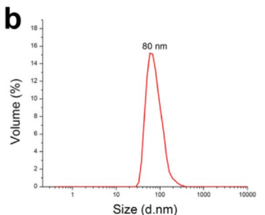
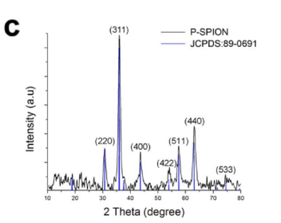
4.Results and discussion Synthesis of P‑SPIONs

Slide 20
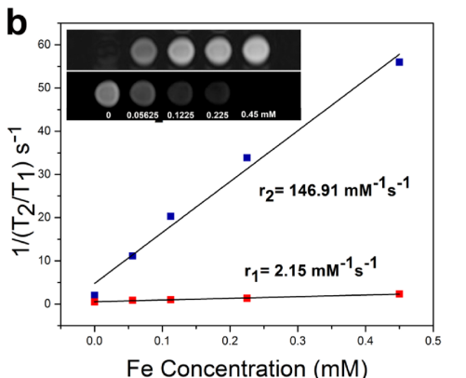
4.Results and discussion Magnetic property and hyperthermia

Slide 21
4.Results and discussion Magnetic property and hyperthermia

Slide 22
4.Results and discussion In vitro evaluations

Slide 23
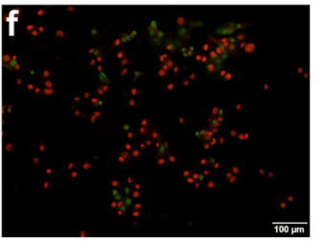
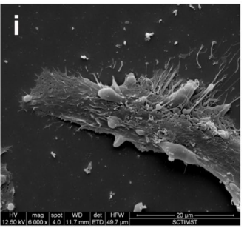
4.Results and discussion In vitro evaluations

Slide 24
4.Results and discussion In vivo MRI of liver fbrosis animal model

Slide 25
4.Results and discussion In vivo MRI of liver fbrosis animal model
Post contrast T2 weighted images of liver showed significant hypo-intensity
with a reduction in the signal intensity (SI) .
On detailed inspection of the MR image, the presence of few streaky linear hyper intense areas is visualized in the hypo intense liver, indicating the fibrotic regions in the affected liver.
The difference in pre to post contrast signal intensity ratio is statistically significant. (p<0.05)
although other receptors on hepatocytes such as the retinoic acid receptor, bile receptor, , low-density lipoprotein and high-density lipoprotein receptor may be targeted, ASGPR, hepatic lectin, a protein that has affinity towards oligosaccharide chains and hence, is an ideal target for hepatocyte-specifc delivery.

Slide 26
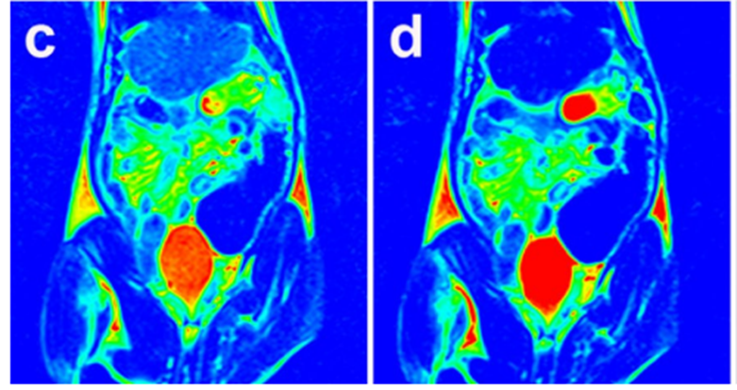
4.Results and discussion In vivo optical imaging
Lower intensity of signal in other organs suggests lower affinity of the probe to organs other than liver, leading to organ specific imaging .
By integrating dual imaging efficacy, PSPION-AT could be used for optical imaging as well.
Overall, the developed P-SPIONs might serve as an excellent hepatocyte specific MR contrast agent and PSPION-AT as a liver targeted fluorescent probe for the early diagnosis of liver abnormalities.

Slide 27
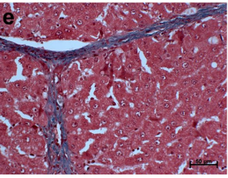
4.Results and discussion Histopathology

Slide 28
5.Conclusions
In summary, a new iron oxide based hepatocyte specific MR contrast agent, P-SPION was successfully synthesized and the in vivo MR imaging of liver fibrosis was successfully evaluated.
In vitro studies revealed the hyperthermic effect of the P-SPIONs by the application of varying magnetic field there by proving the feasibility for therapeutic application.
The potential of pullulan stabilization for liver targeting via ASGPR was well proven on comparison with the SPIONs stabilized with citrate and dextran.
Considering all the factors concerned with early detection of liver diseases, P-SPIONs can be considered as a new platform for in vivo liver imaging.
The multimodal imaging efficiency of the probe integrating with NIR emitting Atto dye also revealed the immense scope of the probe in medical theranostics.

